Slide 1

Cognitive Style & Cognitive Processes “Cognitive style refers to the way individuals think, perceive, and remember information,. Cognitive Processes includes Perception and attribution, personality and attitudes, motivation & Positive Psychology”
Sanjeeva Perera
Senior Academic Fellow - Faculty of Computing

Slide 2

Lecture 2 – Cognitive Style and Cognitive Processes
Cognitive style refers to the way individuals think, perceive, and remember information. It is a concept used in cognitive psychology to describe the unique patterns of thought that people employ to develop their knowledge base about the world around them.
Cognitive style plays a significant role in personal development planning, influencing how individuals approach learning, problem-solving, and decision-making.

Slide 3
In this Lecture you will learn:
Cognitive Style
Cognitive Style Test
Cognitive Processes
Perception and Attribution
Personality and attitudes
Big Five Personality Test
Locus of Control Test
Motivation
Positive Psychology

Slide 4
Five Core Aspects of Self-Awareness
Core Self-evaluation
Underlying personality
Values
Personal standards and moral judgment
Cognitive Style --------→ Lecture 2
Information acquisition and evaluation
Attitudes towards Change
Adaptability and responsibility
Emotional Intelligence
Emotional and awareness and control
Notes:
OK, so we’re going to spend some time today looking at various ways you can gain a deeper understanding of yourself.
Whetton and Cameron identify FIVE CORE aspects of self awareness.
CORE SELF EVALUATION captures the essential aspects of personality and we’ll look at a number of tools and theories that have been developed to explore this.
VALUES relates to your underlying personal standards and moral judgement and, in fact, recognizing your values, and those of others, is really important because values have been found to influence attitudes, preferences and behaviours.
COGNITIVE STYLE explores how individuals gather and process information and researchers have found that differences in cognitive style influence perception, learning, problem solving ability, decision making and creativity – all of which are important factors in Leadership and Management.
ATTITUDE TOWARDS CHANGE focuses on an individual’s ability to cope with change and deal with ambiguity and the methods that they use to achieve this.
And finally, EMOTIONAL INTELLIGENCE relates to emotional awareness and control and the ability to manage yourself and relationships with others. In fact emotinal intelligence has been found by researchers to be one of the most important factors in accounting for success in Leaders and Managers.
So, we’ll look at each of these in more detail now.

Slide 5
Cognitive Style
How we perceive, interpret and respond to information
Knowing (emphasis on facts, details and data)
Planning (emphasis on structure, preparation and planning)
Creating (prefer experimenting, non-rational thinking, and creativity)
Cools, E. & Van den Broeck, H. (2007) Development and validation of the Cognitive Style Indicator. The Journal of Psychology, 141, 359-387.
Notes:
Cognitive Style relates to how we perceive, interpret and respond to information.
No one is predestined to think in a particular way so cognitive style is something that you can easily change through training and practice.
Cools and van den Broeck identified three types of cognitive style: Knowing, Planning and Creating.
The three dimensions are independent so you can score high or low across all three. However, you are likely to demonstrate a preference.

Slide 6
Cognitive Style (1)
Are you a person who can be described as follows:
Focus on facts and details, likes precision
Like to solve problems/make decisions
Like to do things correctly
Good at presenting data based on evidence
Dislike unexpected behaviour?
Notes:
This represents a Knowing style.
If you have a Knowing style you are likely to excel at presenting convincing arguments based on evidence and prefer problems which have one correct answer.
Students with a knowing style tend towards subjects such as physical sciences, law and IT.

Slide 7
Cognitive style (2)
Or, are you are person who can be described as follows:
Like careful preparation, planning and structure
Think things through logically
Organise material logically
Likes rules and routine?
Notes:
This represents a Planning Style.
If you have Planning Style you are likely to prefer systematic methodology, organisation and logic. You are likely to excel at processing a wide range of information into concise, cohesive and logical forms.
Students with a planning style tend towards subjects such as accounting, operations and medicine and prefer jobs in which gathering information is central.

Slide 8
Cognitive Style (3)
Or, finally, are you are person who can be described as follows:
Like experimentation
Creative – likes to brainstorm
Happy with uncertainty and risk-taking
Imaginative and emotional
Likes many insights?
Notes:
This represents a Creating Style.
Those with a Creating Style tend to resist rules and procedures and enjoy brainstorming in groups. Students with a preference for a Creating Style tend towards subjects such as the arts, english and psychology.

Slide 9
Cognitive Style
Knowing
Planning
Creating

Slide 10
Does Cognitive Style matter?
People often use preferred style no matter what the problem is
for a given problem, some students focus of getting more information whilst others will introduce more procedures.
Notes:
How does Cognitive Style impact on Leadership and Management?
It is important to note that Cognitive Style is NOT a determinant of general intelligence. Intelligent people may score low or high on any of the indicators. However, it will influence your behaviour and the way you respond to problems.
People tend to revert to their preferred style no matter what the problem is and managers tend to define problems according to their own preferred style e.g. in one study (Whetton and Cameron, pg 98) managers were given identical problems and asked what the solution was. Some thought the solution was to get more data (knowing), some thought a new process should be developed (planning) and some though that it required brainstorming to generate new ideas (creating).

Slide 11
Possible Problems
Knowing
Slow decision making, resistant to innovation, intolerant of multiple views
Planning
Intolerant of ambiguity, resistant to change, stunned by confusion, can’t handle illogical issues/views
Creating
Resistant to structure, wants to break rules, can make mistakes, can ignore data and facts.
Notes:
It is also useful to be aware of possible liabilities/weaknesses associated with each style. Be aware of these tendencies both in yourself and in those you manage.

Slide 12
Cognitive Style Test
Cognitive Style Indicator Test and Scoring (CoSI) –
XLS file attached to Course web
Notes:
It is also useful to be aware of possible liabilities/weaknesses associated with each style. Be aware of these tendencies both in yourself and in those you manage.

Slide 13
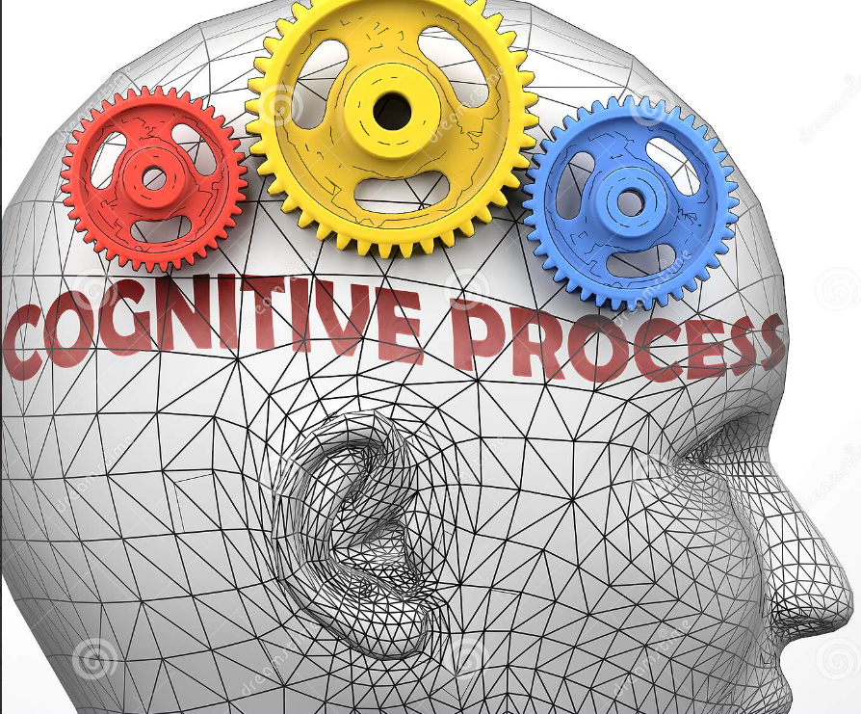
Cognitive Processes Cognitive comes from the Latin cognito, meaning to Apprehend or understand Cognition- A general term including all mental processes by which people become aware of and understand the world. (This explain why people are different)

Slide 14
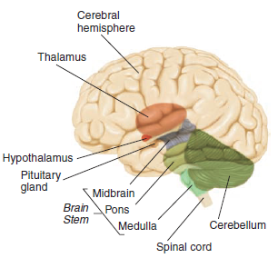
Cognitive process (Hardwired vs Softwired)
The term hardwired suggests that a behavior or thought is innate and natural; that is, just the way it is. The macro-structure of the brain (including the basic plan anatomy, structure, and processing) are mostly hardwired and can't be modified. However, the human brain is also soft-wired; it is modifiable
These Cognitive processes are (softwired)
Perception and attribution
Personality and Attitudes
Motivational needs & Processes
Positive Psychological Capacities

Slide 15
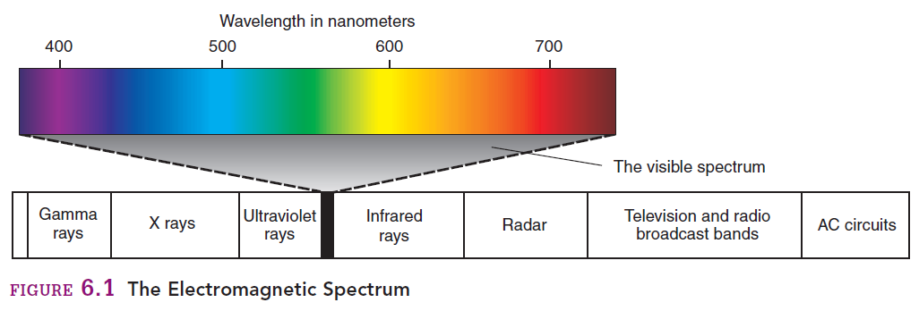
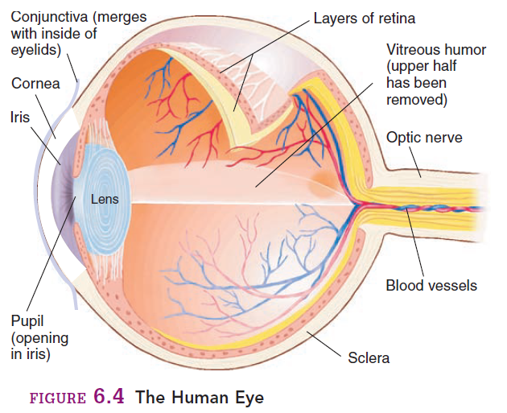
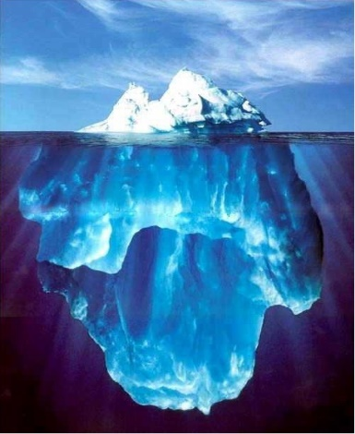
Perception and attribution
Perception : The process by which people select, organize, interpret, retrieve, and respond to information.
Perceptual information is gathered from:
Sight.
Hearing.
Touch.
Taste.
Smell.
Perception vs. Reality (Video-Dove commercial)
Perception is more complex and much broader that sensation(Physical senses).
Perceptual Process (Filter) defined as complicated interaction of selection, organization, and interpretation.
This Filter will completely change, modify the sensory data (Vision, hearing, touch, smell and taste).

Slide 16
Perceptual Selectivity –External Factors
Contrast ( External stimuli that stand out against the background)

Slide 17
Attribution
Definition: The ways in which people come to understand the causes of their own and others’ behaviors
Most often an unconscious process (i.e., people are not normally aware of making attributions)
People are constantly attributing the behavior of themselves and others to either internal (i.e., personal) or external (i.e., situational) causes.

Slide 18
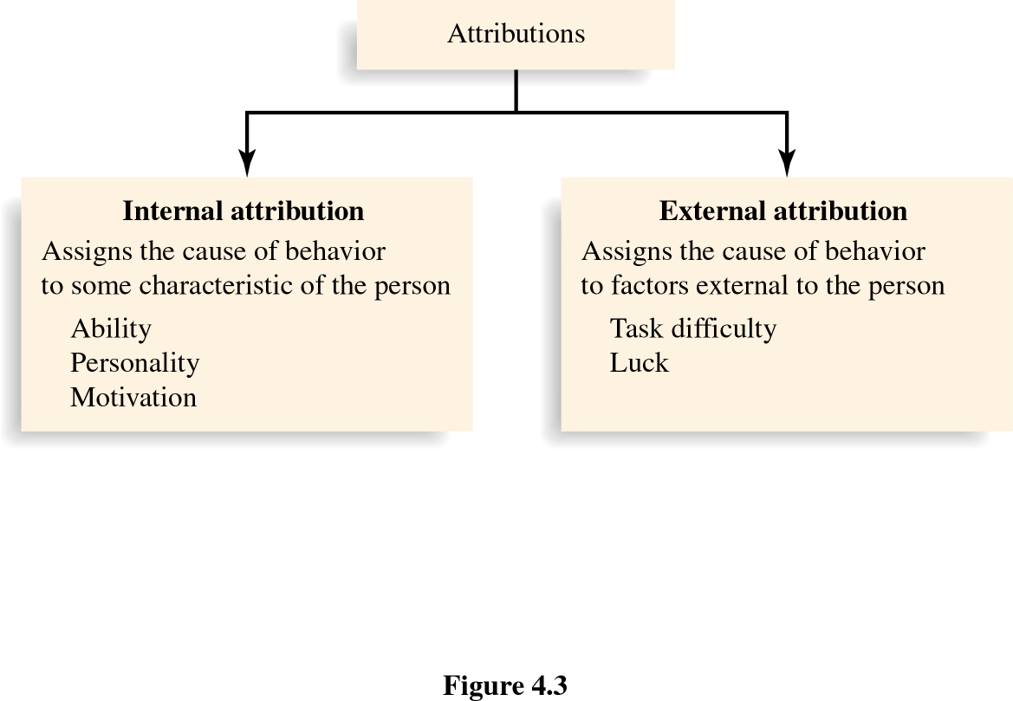
Types of Attributions

Slide 19
Attribution Biases
Fundamental Attribution Error - tendency to make attributions to internal causes when focusing on someone else’s behavior
Self-serving Bias - tendency to attribute one’s own successes to internal causes and one’s failures to external causes

Slide 20
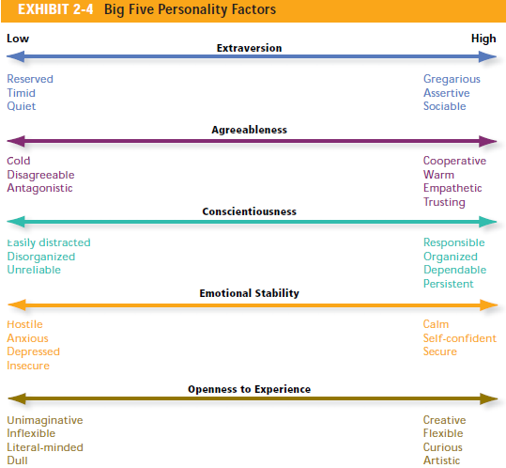
Personality and Attitudes
Personality
The unique qualities of an individual and how those qualities affect understanding of themselves and others
Is Personality Changeable?

Slide 21
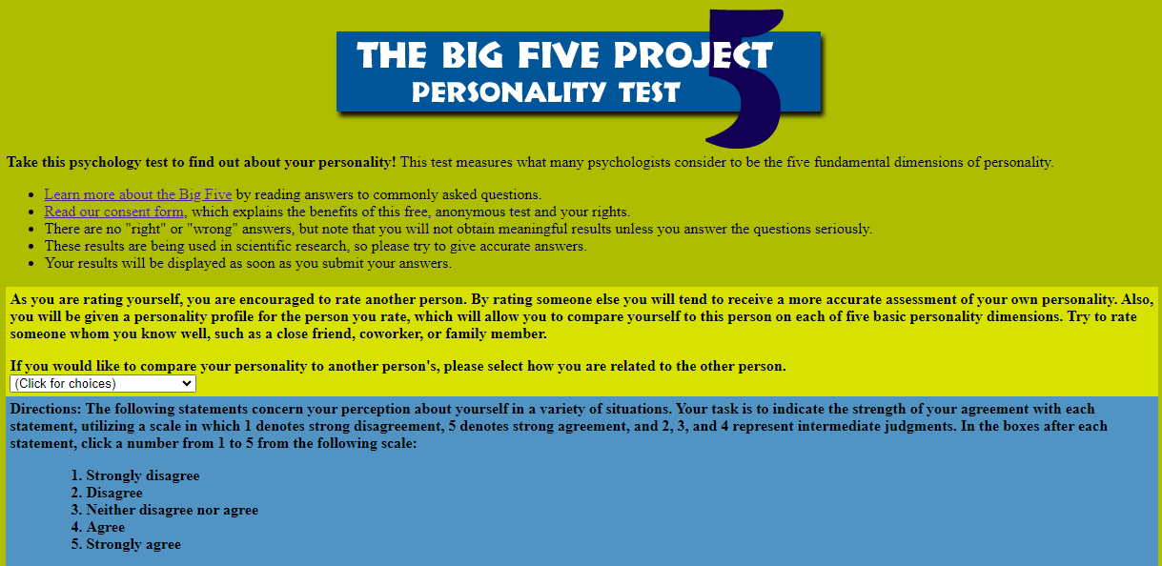
Big Five Personality Test
https://www.outofservice.com/bigfive/

Slide 22
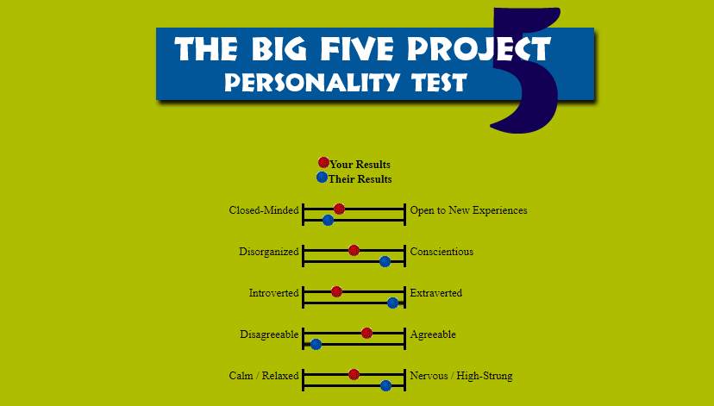
Big Five Personality Test – Sample Result

Slide 23
Core Self Evaluation Traits
Self-Esteem
Your belief as to your competence and your image
High self-esteem – positive attitudes, feelings, and satisfaction
Locus of Control
Generalized Self Efficacy
Neuroticism (emotional stability)

Slide 24
Personality Characteristics
Self-Esteem
Feelings of Self Worth
Success tends
to increase
self-esteem
Failure tends
to decrease
self-esteem
Notes:
11
11
11
10

Slide 25
Personality Characteristics in Students
Locus of Control
Internal
External
People and circumstances control my fate!
I control what
happens to me!
Notes:
9
9
9
8

Slide 26
Locus of Control Test
Locus_of_Control_-_Test_and_Scoring
XLS file attached to course web
Source: Whetton, D. and Cameron, K.(2007) Developing Management Skills (edition 8, 2011, is now available).
This is adapted from the original test designed by Julian Rotter in the 1960s.
Notes:
9
9
9
8

Slide 27
Personality Characteristics
Generalized Self-Efficacy - beliefs and expectations about one’s ability to accomplish a specific task effectively
Sources of self-efficacy
Prior experiences and prior success
Behavior models (observing success)
Persuasion
Assessment of current physical & emotional capabilities
Notes:
10
10
10
9

Slide 28
Attitude Model
genetics
Informational/
Cognitive
(i.e. beliefs)
Attitude
Behavior
socialization
Affective
(i.e. emotions)
Measurable in
the brain with fMRI
(functional Magnetic
Resonance Imaging)
observable
learning

Slide 29
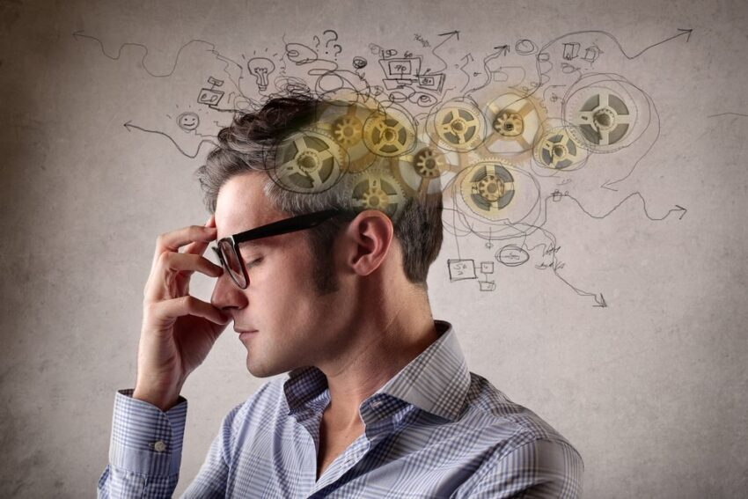
Motivation
Motivation is a Latin word Motive …..> English “Mover”
Motivation is a process that start with a physiological or psychological deficiency or need that activates a behavior or a drive that is aimed at a goal or incentive.
NEEDS ------------------------------------------------> DRIVES ------------------------------------------------> INCENTIVE
OR DEFICIENCY
Needs : e.g. when body deprived of food and water
Drives (motives) : e.g. hunger and thirst drives
Incentives : e.g. Eating food and drinking water
Why are people motivated to do those things? VIDEO (TV
Commercials Anti boredom)

Slide 30

The Art of Possibility
Zander and Zander (2002)
A shoe factory sent two marketing scouts to a region in Africa to study the prospects for expanding business. One sends back a telegram saying, SITUATION HOPELESS STOP NO ONE WEARS SHOES
The other writes back victoriously, GLORIOUS BUSINESS OPPOTURNITY STOP THEY HAVE NO SHOES”.

Slide 31
Positive Psychology
“Positive psychology is the scientific study of what makes life most worth living” (Peterson, 2008). It is different to other approaches in the field as it has a focus on the strengths of a individual and what could make them function at a greater level, as opposed to focusing on repairing someone so they can function at a ‘normal’ level. Positive Psychology can help to change your outlook, and small shifts in perspectives can help to facilitate bigger changes.
Video - ‪Prof. Fred Luthans on Psychological Capital‬‏

Slide 32

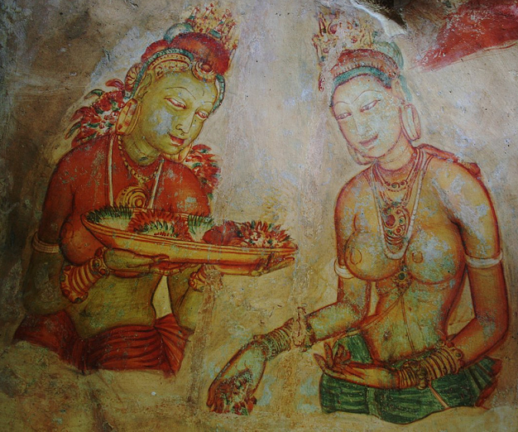
Positive Psychology (application of Positive Phycology)
Sigiriya rock,
Sri Lanka
A Wonder work of King Kasiyappa
(fortress built during 477 - 495 AD).

Slide 33

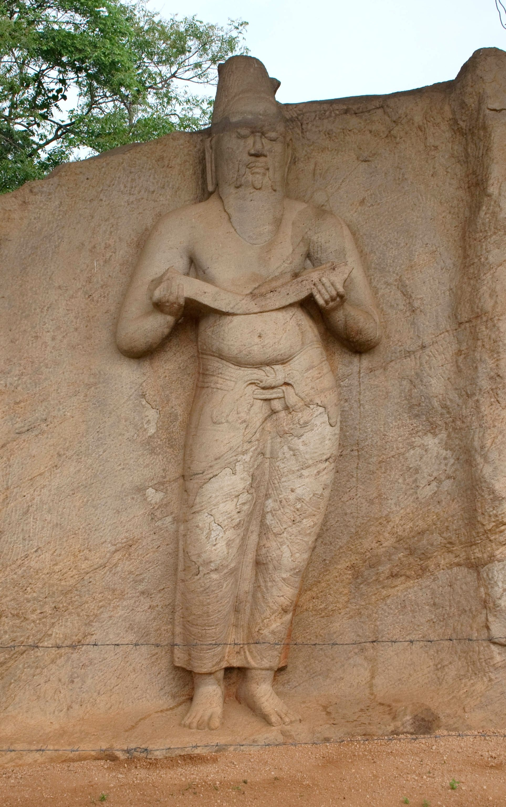
Positive Psychology (application of Positive Phycology)
The Sea of Parakrama (Parakrama Samudraya)
Mahā Parākaramabāhu constructed extensive irrigation systems (from 1153 to 1186 – 12th Century)

Slide 34
Positive psychology States
Several important positive psychology states are emerging to help in both the better understanding and effective application of positive psychology
Optimism
Resilience
Hope
Confidence
Psychological Well-Being (Happiness)
Emotional Intelligence
Positive psychology States

Slide 35
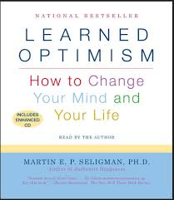
Optimism- Prof. Martin Seligman: attribution of failures
Optimistic - Cognition and Emotion
External (not their fault), Unstable (temporary setback), Specific(problem only in this situation) attributions
Pessimistic
Internal (their own fault), Stable (will last long time) and Global (it happens every time) attributions

Slide 36
Resilience
“a class of phenomena characterized by patterns of positive adaptation in the context of significant adversity or risk”
Beyond simple adaptation and coping, it is the ability to rebound and bounce back from adversity (e.g. Tsunami in Sri Lanka)
In the beginning scientists thought it was for a select few gifted children. Now we know otherwise, that it can be enabled.
In the beginning scientists thought it was fixed, now we know it can be developed.

Slide 37
Think about how you can use your strengths to build resilience to challenges.

Slide 38

Hope and Happiness
Multiple pathways to accomplish goal
Hope
Agentic Capacity (“will power”) agency or goal directed energy
Pathways Thinking (“way power”)
No pathways to accomplish goal, no subsequent hope the goal will be accomplished?

Slide 39
Hope and Happiness
(Continued)
Happiness or Subjective Well-Being (SWB)
The Role of Goals
Aspiration goals that are set too high or too low have been found to be detrimental to SWB (i.e. anxiety on the too high end and boredom on the too low end)
Across Cultures → Job Satisfaction
Wealthier nations have higher level of SWB

Slide 40
Confidence - Self Efficacy
“Orville Wright did not have a pilot’s license”
Video - Wright brothers: Wilbur and Orville Wright, inventors of the airplane
So, what did he have? Confidence
Video - Lion vs Man - Stealing meet from Lions

Slide 41
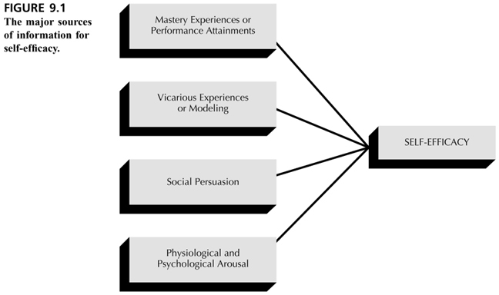
Sources of Self-Efficacy
Situational (e.g. complexity of the task) cognitive (e.g. Perception of one’s ability)
If people see others like themselves succeed by sustained effort, they believe that they ,too, have the capacity to succeed.
“Can do” approach
Very tired or lot of pressure less confidence.
Excellent physical and mental condition high confidence

Slide 42
Emotional Intelligence

Slide 43
Types of Emotions
Positive Primary Emotions
Other Descriptors
Love/affection
Happiness/joy
Surprise
Acceptance, adoration, longing, devotion, infatuation
Cheerfulness, contentment, bliss, delight, amusement,
enjoyment, enthrallment, thrill, euphoria, zest
Amazement, wonder, astonishment, shock
Negative Primary Emotions
Other Descriptors
Fear
Sadness
Anger
Disgust
Shame
Anxiety, alarm, apprehension, concern, qualm, dread,
fright, terror
Grief, disappointment, sorrow, gloom, despair,
suffering, dejection
Outrage, exasperation, wrath, indignation, hostility,
irritability
Contempt, disdain, abhorrence, revulsion, distaste
Guilt, remorse, regret, embarrassment, humiliation

Slide 44
Daniel Gardner’s Multiple Intelligences
Original Intelligences
Characteristics
1. Logical/mathematical
2. Verbal/linguistic
3. Interpersonal
4. Intrapersonal
5. Visual/spatial
6. Musical
7. Bodily/kinesthetic
Processes analytically, calculates, quantifies
Thoughts through words, uses word to nurture
Understands others, processes through interaction,
empathizes, humor
Thinks in quiet, likes to be alone, goal oriented
Uses mental models, thinks three dimensionally,
pictures how to get places or solve problems
Sensitivity to pitch, melody, rhythm
Physical movement, involves the whole body,
processes by jumping or dancing
“New” Intelligences
Characteristics
8. Naturalist
9. Existential
10. Emotional
Need to be with/survive in nature, strength in
categorization in nature or urban world
Not religion per se, knowing why you are here,
personal mission
Emotionally mature, recognize own anger, reacts to
emotions of self and others

Slide 45
Emotional Intelligence (EI)
(Continued)
Emotional Intelligence in the Workplace
Definition: the capacity for recognizing our own feelings and those of others, for motivating ourselves, and managing emotions well in ourselves and in our relationships.
Emotional Intelligence at Work – Video (IQ vs EI)
First Moon Landing 1969 – Video
(Neil Armstrong was the first man to set foot on the moon with his legendary words "One small step for man, a giant leap for mankind.“)

Slide 46
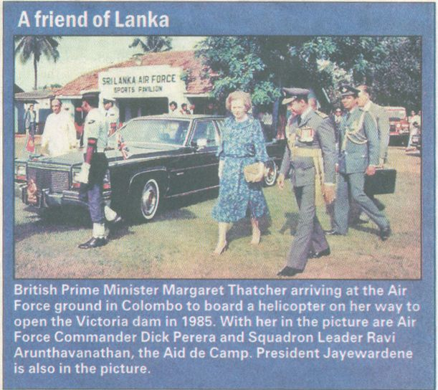

Victoria dam Story (application of Positive Phycology)
වික්ටෝරියා වේල්ල පෙන්වා ජේ.ආර් ජයවර්ධන එලිසබෙත් රැජිණගෙන් ආධාර ගත් හැටි

Slide 47
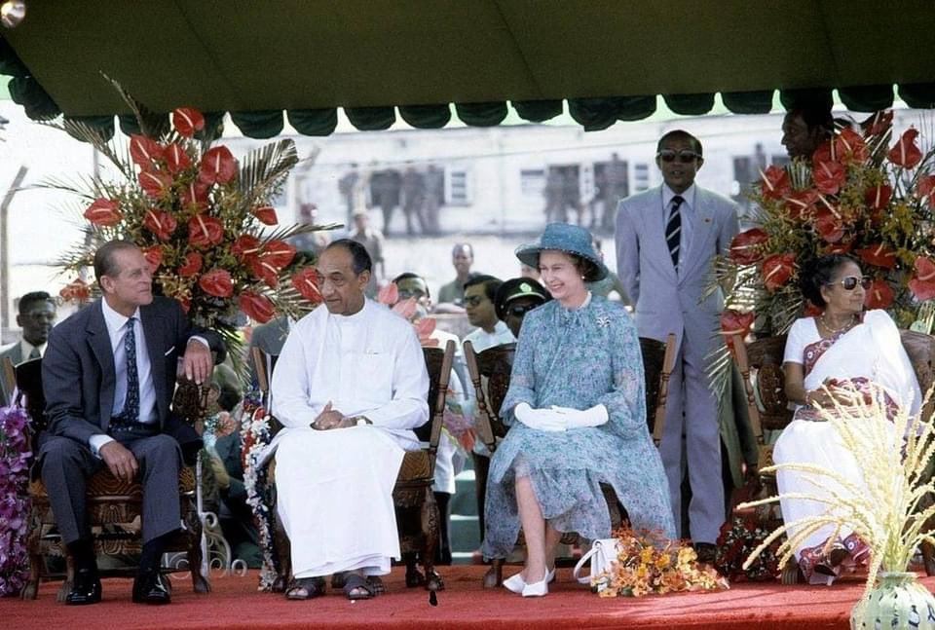
Her Majesty Queen Elizabeth II Royal visit to Sri Lanka 21st-25th October 1981 to attend the celebrations marking 50 years of universal adult franchise in Sri Lanka

Slide 48
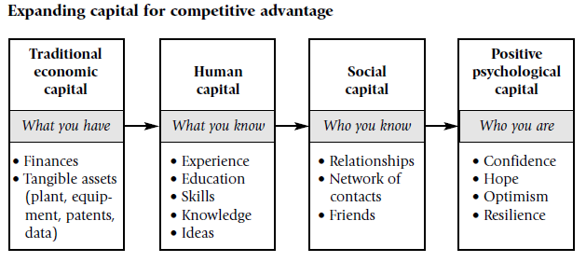
Positive psychological capital: Beyond human and social capital

Slide 49
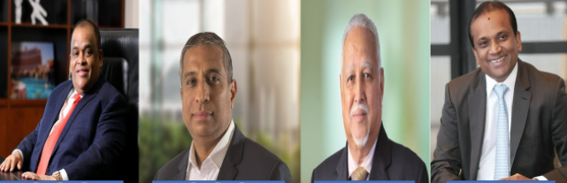
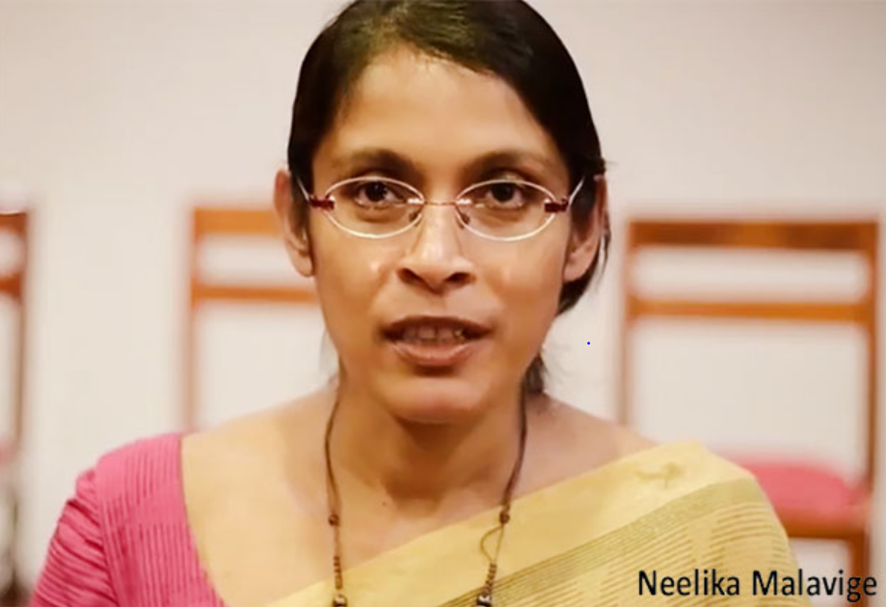
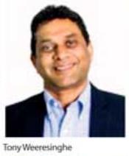
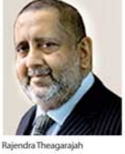
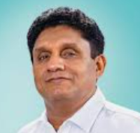
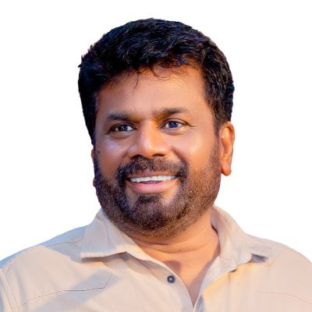
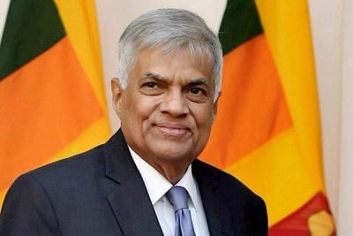

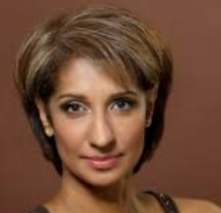
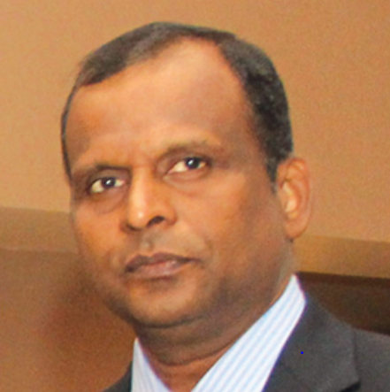
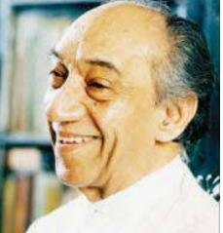
Positive psychological capital: Beyond human and social capital
Traditional Economic Capital
(What you have)
Human Capital
(What you Know)
Social Capital
(Who you Know)
Positive Phycological Capital
(who you are)

Slide 50
Five Core Aspects of Self-Awareness
Core Self-evaluation
Underlying personality
Values
Personal standards and moral judgment
Cognitive Style
Information acquisition and evaluation
Attitudes towards Change
Adaptability and responsibility
Emotional Intelligence
Emotional and awareness and control
Covered During this lecture …..
Notes:
OK, so we’re going to spend some time today looking at various ways you can gain a deeper understanding of yourself.
Whetton and Cameron identify FIVE CORE aspects of self awareness.
CORE SELF EVALUATION captures the essential aspects of personality and we’ll look at a number of tools and theories that have been developed to explore this.
VALUES relates to your underlying personal standards and moral judgement and, in fact, recognizing your values, and those of others, is really important because values have been found to influence attitudes, preferences and behaviours.
COGNITIVE STYLE explores how individuals gather and process information and researchers have found that differences in cognitive style influence perception, learning, problem solving ability, decision making and creativity – all of which are important factors in Leadership and Management.
ATTITUDE TOWARDS CHANGE focuses on an individual’s ability to cope with change and deal with ambiguity and the methods that they use to achieve this.
And finally, EMOTIONAL INTELLIGENCE relates to emotional awareness and control and the ability to manage yourself and relationships with others. In fact emotinal intelligence has been found by researchers to be one of the most important factors in accounting for success in Leaders and Managers.
So, we’ll look at each of these in more detail now.

Slide 51
Questions ?

